Slide 1

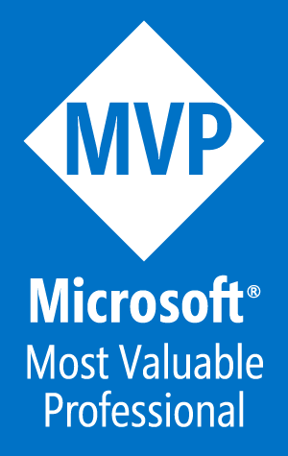

Microsoft Fabric
Sessão 3 Data Warehousing o método tradicional também funciona
Armando Lacerda
Azure Cloud Architect Independent Consultant
Tiago Balabuch
Cloud Solutions Architect
Notes:
Both

Slide 2
Agenda
Data Warehousing and Lakehouse
Starting from where you are
Demos

Slide 3








OneLake
Data Factory
Data Warehouse
Data Engineering
Data Science
Real Time Analytics
Data Activator
Power BI

Slide 4

Data Warehouse

Slide 5
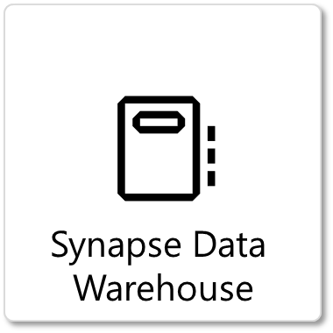
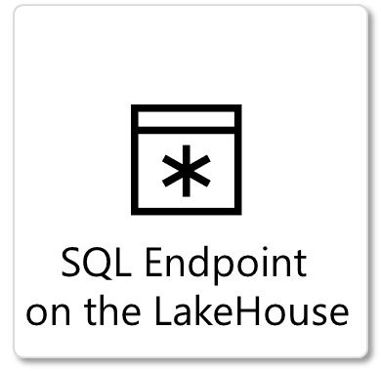
Two ways to work in T-SQL in Microsoft Fabric

Slide 6
Use the tools you’re familiar with
SQL Server Management Studio
Azure Data Studio
Microsoft Fabric SQL Query Editor
Any SQL Server Client or library.
Any delta-parquet client or library (over ADLS Gen2 endpoint).

Slide 7
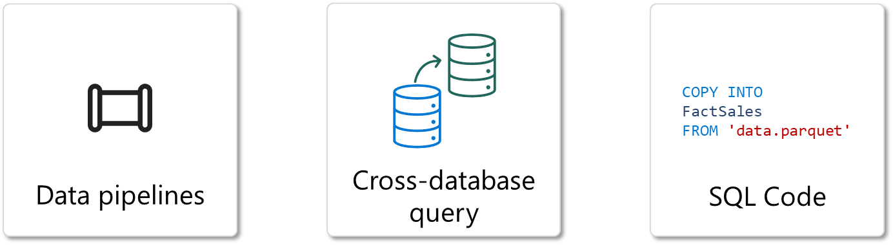
You can ingest data in Data warehouses as usual

Slide 8
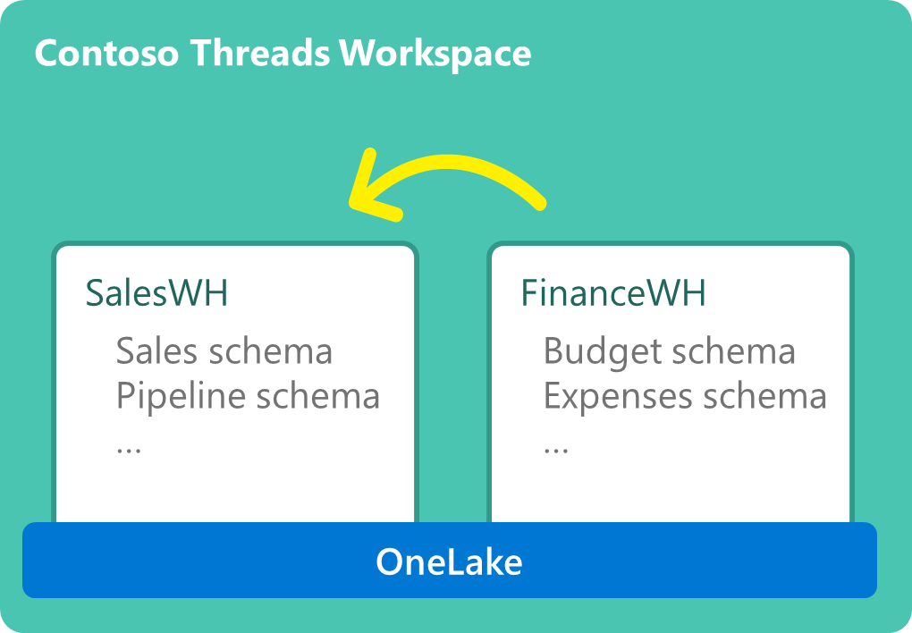

Slide 9
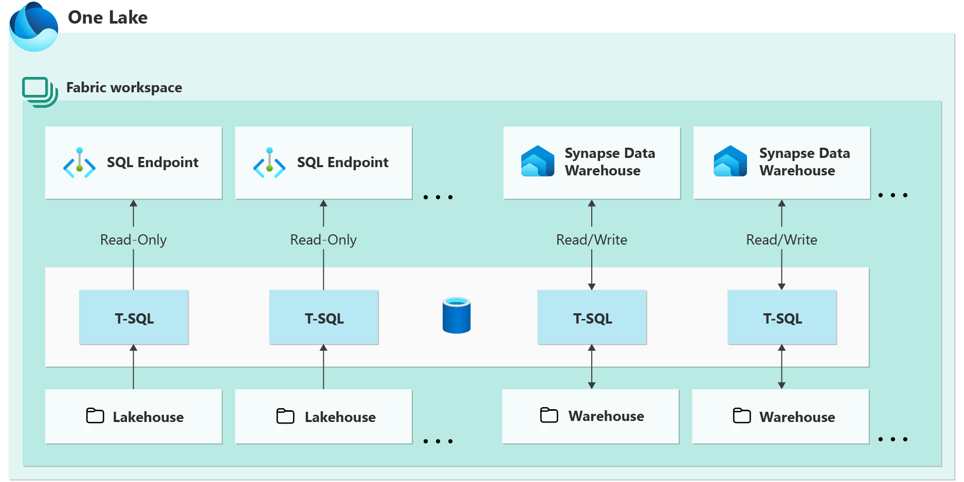

Slide 10
Demos

Slide 11
Nos vemos na próxima sessão.
Armando Lacerda
Azure Cloud Architect Independent Consultant
Tiago Balabuch
Cloud Solutions Architect
Notes:
Armando and Tiago

